Slide 1

CENG 789 – Digital Geometry Processing
04- Mesh Data Structure and 3D Graphics Programming
Assoc. Prof. Yusuf Sahillioğlu
Computer Eng. Dept, , Turkey

Slide 2
Mesh Data Structure
<number> / 25
Polygon mesh: set of polygons embedded in 2D or 3D.
Polygon mesh: set of vertices, edges, and faces embedded in 2D or 3D.
Lets handle these vertices, edges, faces in a structured way, hence the mesh data structure.

Slide 3
Mesh Data Structure
<number> / 25
How to store geometry & connectivity of a mesh.
3D vertex coordinates Vertex adjacency
Attributes also stored: normal, color, texture coords, labels, etc.
Efficient algorithms on meshes to get:
  All vertices/edges of a face.
  All incident vertices/edges/faces of a vertex.

Slide 4
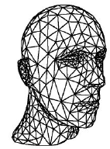
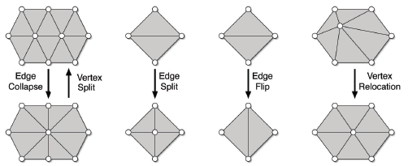
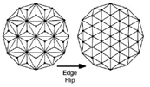
Mesh Data Structure
<number> / 25
Classical queries:
  What are the vertices of face 77?
  Is vertex 7 adjacent to vertex 17?
  Which edges are incident to vertex 27?
  Which faces are incident to vertex 27?
Classical operations:
  Remove/add vertex/face.
  Split/collapse/flip edges.
  Change vertex coordinates.
  Topological vs. geometrical.

Slide 5

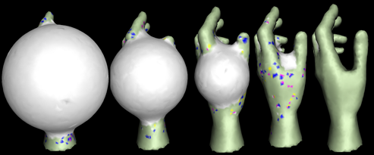
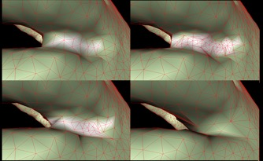
Mesh Data Structure
<number> / 25
Applications of edge split:
Increase resolution to catch details in 3D reconstruction
  Paper: Shape from silhouette using topology-adaptive mesh deformation
  Split short edge
  if midpoint is OUT:

Slide 6
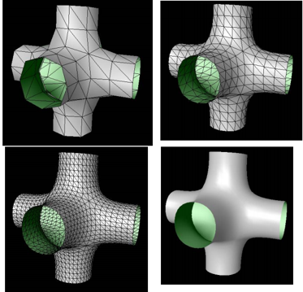
Mesh Data Structure
<number> / 25
Applications of edge split:
Increase resolution for smoother surfaces: Subdivision Surfaces
  Loop subdivision
  32 (original) to 1628
  vertices in 3 iterations:

Slide 7
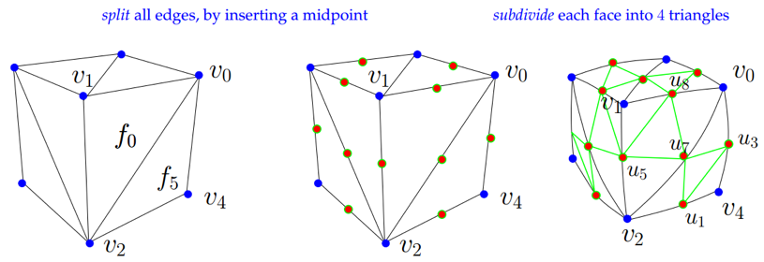
Mesh Data Structure
<number> / 25
Applications of edge split:
Increase resolution for smoother surfaces: Subdivision Surfaces
  Loop subdivision
  Updating the topology (connectivity)

Slide 8
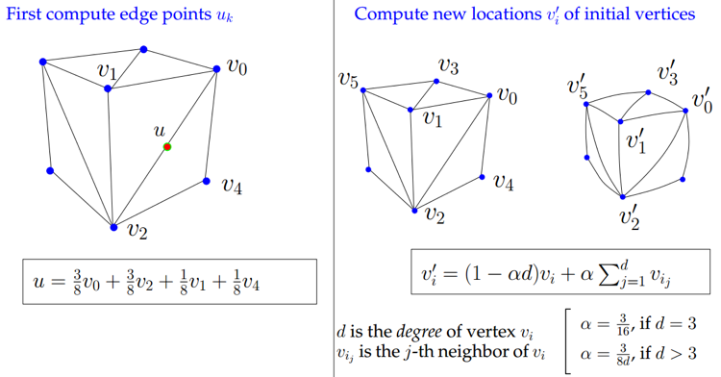
Mesh Data Structure
<number> / 25
Applications of edge split:
Increase resolution for smoother surfaces: Subdivision Surfaces
  Loop subdivision
  Updating the geometry (coordinates)

Slide 9
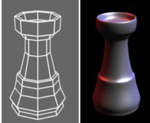

Mesh Data Structure
<number> / 25
Applications of edge split:
Increase resolution for smoother surfaces: Subdivision Surfaces
  Loop subdivision (best for triangle meshes)
  Catmull-Clark subdivision (quad meshes)
  Butterfly subdivision
  Doo-Sabin subdivision
  √3-subdivision
More on this in the Subdivison lecture later in semester.

Slide 10
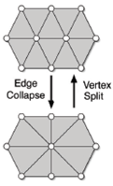
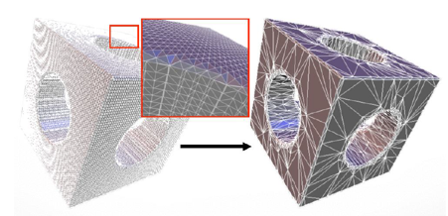
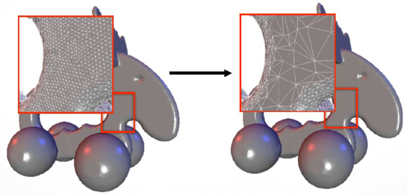
Mesh Data Structure
<number> / 25
Applications of edge collapse:
Decrease resolution for efficiency
  Detail-preserving

Slide 11
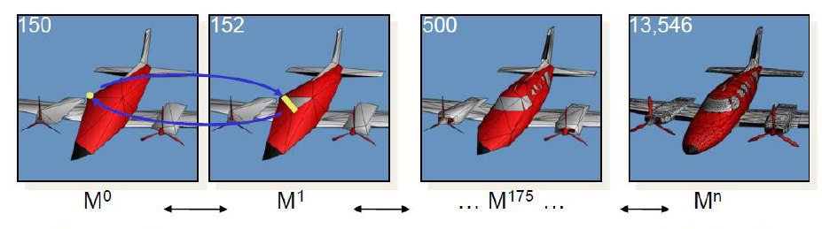
Mesh Data Structure
<number> / 25
Applications of edge collapse:
Decrease resolution for efficiency
  Detail-oblivious (level-of-detail)

Slide 12
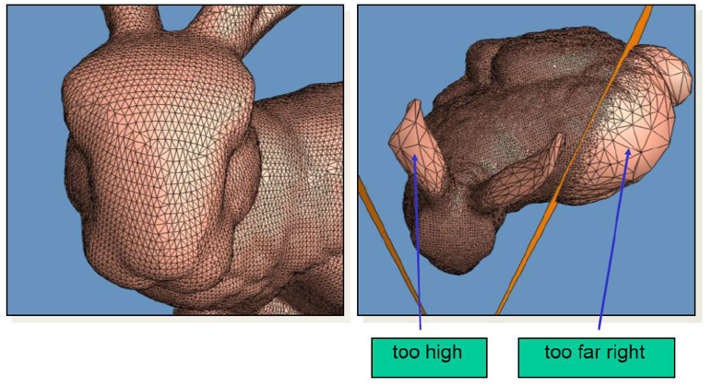
Mesh Data Structure
<number> / 25
Applications of edge collapse:
Decrease resolution for efficiency
  Detail-oblivious (view-dependent rendering)

Slide 13

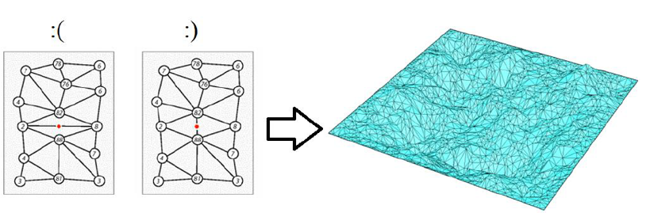
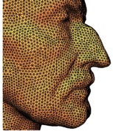
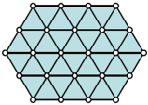
Mesh Data Structure
<number> / 25
Applications of edge flip:
Better triangulations, e.g., w/ less skinny triangles
Finite element modeling, simulations, terrain construction

Slide 14
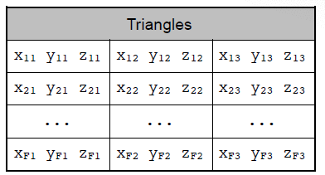
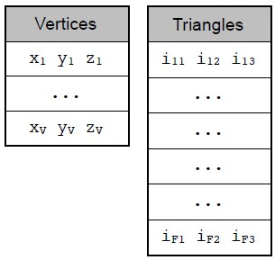
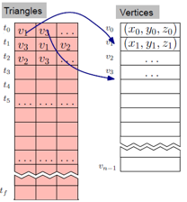
Face-Based Data Structures
<number> / 25
One way to implement a mesh data structure is through faces.
Face-Set data structure. //aka polygon soup ‘cos no connectivity info.
//vertices and associated data are replicated.
Indexed face-set data structure (obj, off, ply formats). Better!!!!
Notes:
Face-set: Using 32-bit single precision numbers to represent vertex coordinates, we need 3 (x-y-z coords) * 3 (# vertices) * 4 (32bit=4bytes) = 36 bytes per triangle. By Euler formula (F ~= 2V), needs 72 bytes per vertex.
Indexed face-set: we need 3 (# indices) * 4 = 12 bytes per triangle (= 24 bytes per vertex). We also need 3 (x-y-z coords) * 4 = 12 bytes per vertex. Total = 36 bytes per vertex, half of the Face-set structure ☺

Slide 15
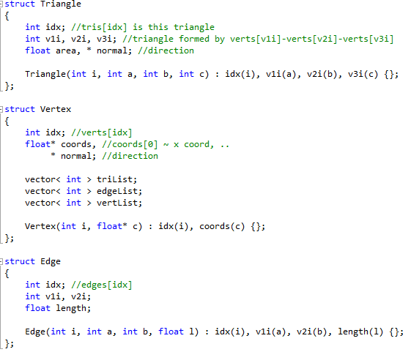
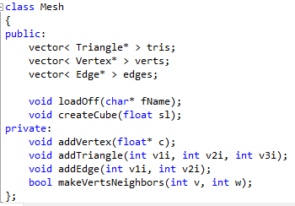
Face-Based Data Structures
<number> / 25
My base code implements Indexed face-set data structure
See http://www.ceng.metu.edu.tr/~ys/ceng789-dgp/MyDemo.zip

Slide 16

Edge-Based Data Structures
<number> / 25
Another way to implement a mesh data structure is through edges.
For explicit storage of edges.
  Enables efficient one-ring enumeration.
Can be done with slight modifications to Indexed face-set.
  Define an Edge struct.
  In addition to coordinates, vertices have refs to Vertexes, Edges, Faces.
  Begin coding to demonstrate this and introduce Open Inventor.
    Read Open Inventor Mentor for detailed Open Inventor programming.
Ready-to-use mesh processing libraries and software:
  CGAL (lib)
  OpenMesh (lib)
  MeshLab (sw)

Slide 17
3D Graphics Programming
<number> / 25
We prefer a high-level object-oriented approach to 3D graphics development.
We also prefer a programming API that brings its own 3D viewer (with trackball navigation and everything).
Coin3D, an independent implementation of Open Inventor, fits best.
  https://youtu.be/lK7aoc1AO8w
  Inventor Mentor: http://www-evasion.imag.fr/Membres/Francois.Faure/doc/inventorMentor/sgi_html/
The Visualization Toolkit (VTK) is a popular alternative.
  https://youtu.be/IgvbhyDh8r0
  Manual: https://www.researchgate.net/profile/William_Schroeder3/publication/200034772_The_Visualization_Toolkit_An_Object-Oriented_Approach_To_3D_Graphics/links/57dfcfa708ae1dcfea865e57/The-Visualization-Toolkit-An-Object-Oriented-Approach-To-3D-Graphics.pdf
Other alternatives are
  libigl: http://libigl.github.io/libigl
  OpenMesh: http://www.openmesh.org
  OpenSceneGraph: https://youtu.be/1l5PAVCj2iY

Slide 18
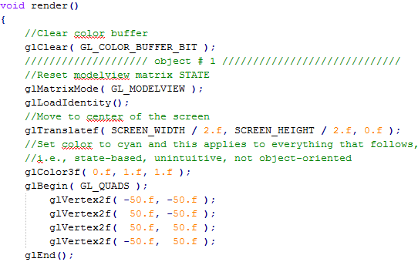
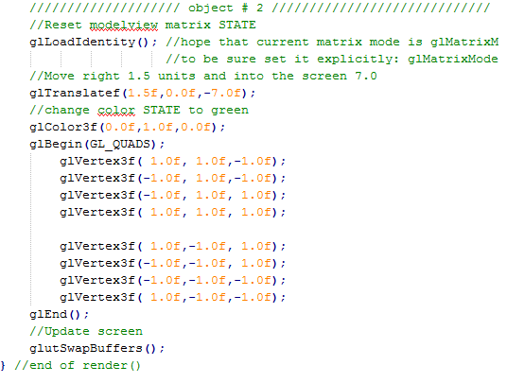
Open Inventor vs. OpenGL
<number> / 25
OpenGL is not object-oriented. It is state-based, unintuitive.

Slide 19
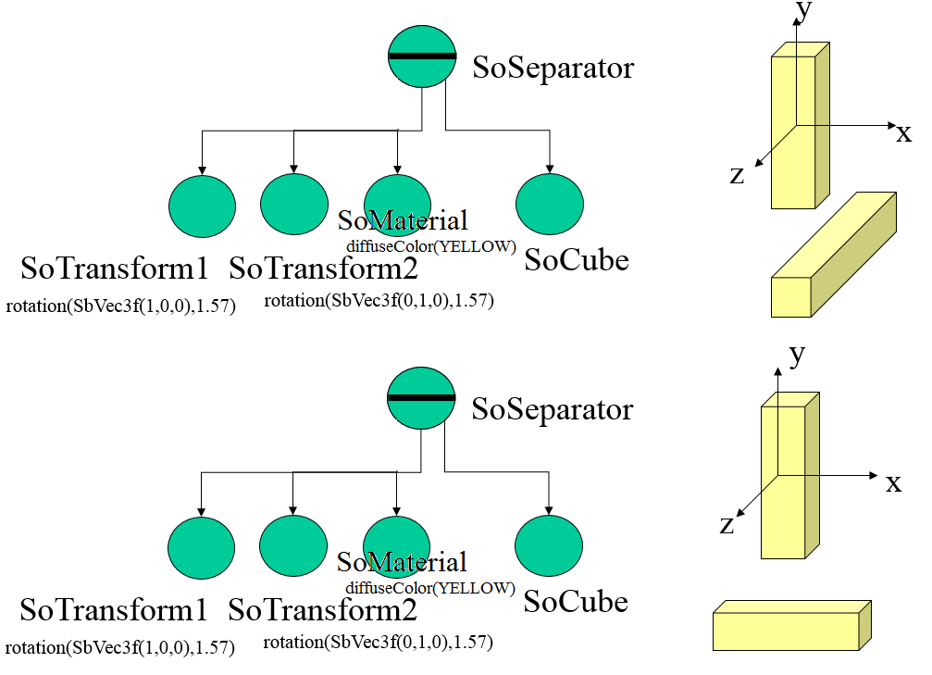
Open Inventor vs. OpenGL
<number> / 25
Open Inventor is object-oriented. Everything on screen is an object (of type SoSeparator) with its own fields/attributes.

Slide 20
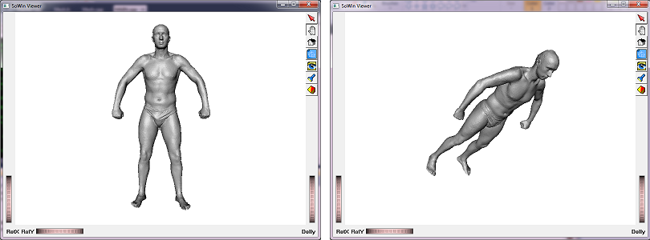
Open Inventor vs. OpenGL
<number> / 25
OpenGL uses a primitive viewer, glut, where you need to implement your own trackball navigation, camera location/lookups, render modes, etc.
Open Inventor uses an advanced viewer (SoWin Windows, SoXt Unix) with built-in trackball navigation, camera handling, render modes, etc.
  https://youtu.be/lK7aoc1AO8w

Slide 21
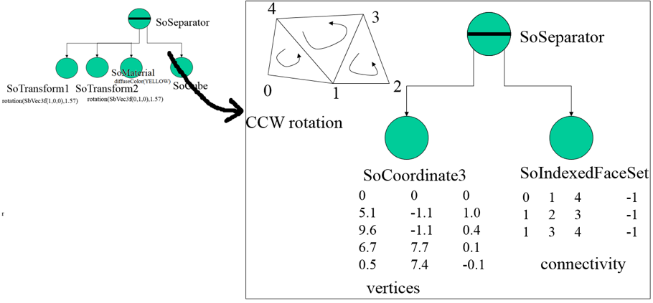
Open Inventor Programming
<number> / 25
Let’s change SoCube with a more generic shape, which is a SoSeparator.

Slide 22
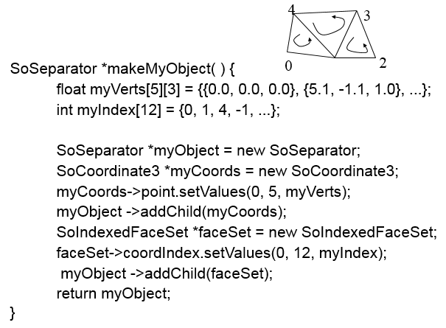
Open Inventor Programming
<number> / 25
The code is dead simple:
Get this info from
MyMesh.cpp for a
more structured code!

Slide 23
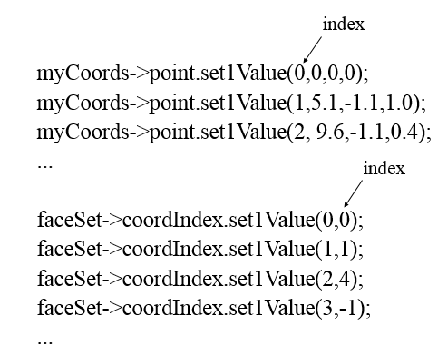
Open Inventor Programming
<number> / 25
The code is dead simple.
  You can also set myCoords and faceSet values one-by-one:

Slide 24
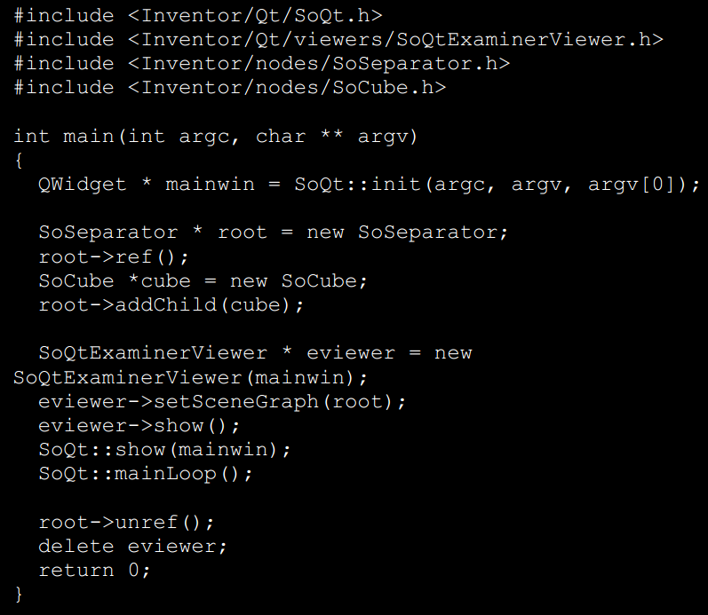
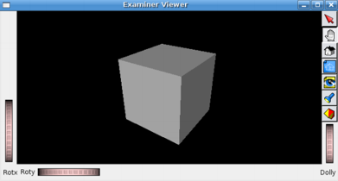
Open Inventor Programming
<number> / 25
Dead simple full code to create and render a cube.

Slide 25
Potential Project Topics
<number> / 25
Implement all schemes in Slide 9 to generate subdivision surfaces.
Implement paper: Progressive Meshes (Slide 11).

